Slide 1


Conducting investigations in Covid Times
18 May 2021

Slide 2
Agenda
Topic | Details
1 | Key frauds investigated during pandemic times and fraud typologies noted How Covid-19 affecting the overall level of fraud? How Covid-19 affecting specific fraud risks?
2 | Key challenges during investigations and key lessons learned How Covid-19 is affecting the ability to fight fraud?
3 | Remediation actions – a must do once a fraud incident is discovered. How could companies better protect against fraud? How Covid-19 if affecting organization’s antifraud programs?

Slide 3
Key frauds investigated during pandemic times and fraud typologies noted
1

Slide 4
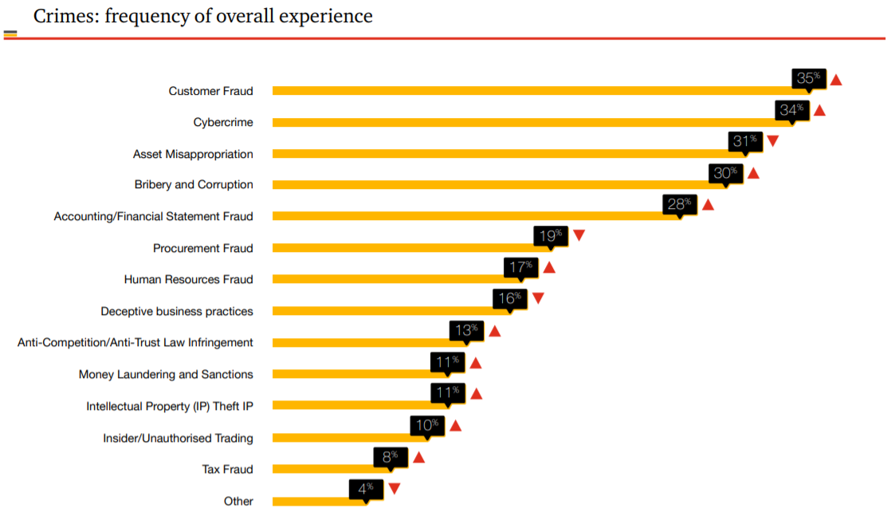
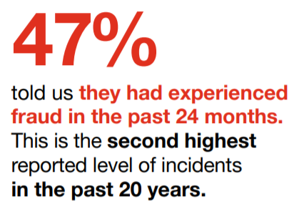
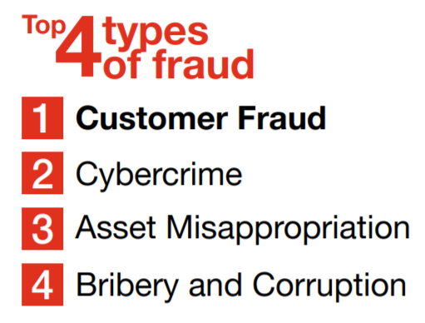
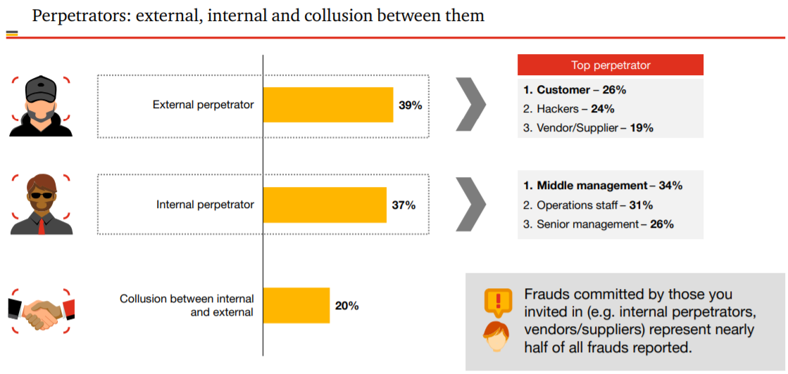
Before Covid-19 - Key economic crimes according to PwC GECS 2020
Source: PwC GECS Report 2020

Slide 5
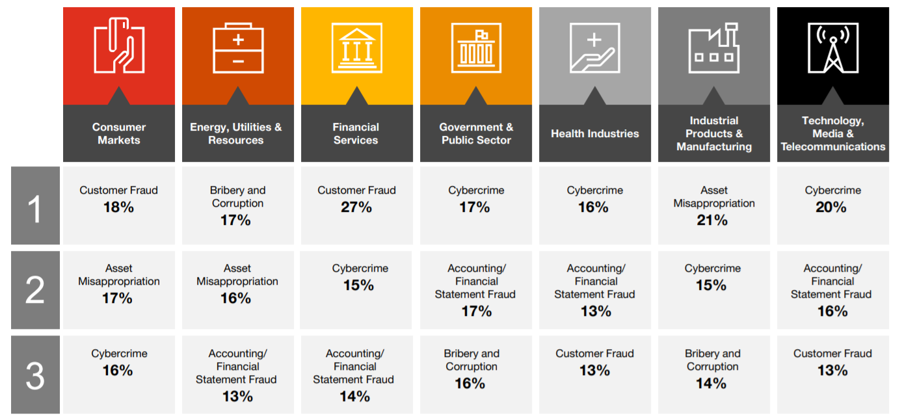
Before-Covid19 - Top types of fraud by industry
Source: PwC GECS Report 2020

Slide 6
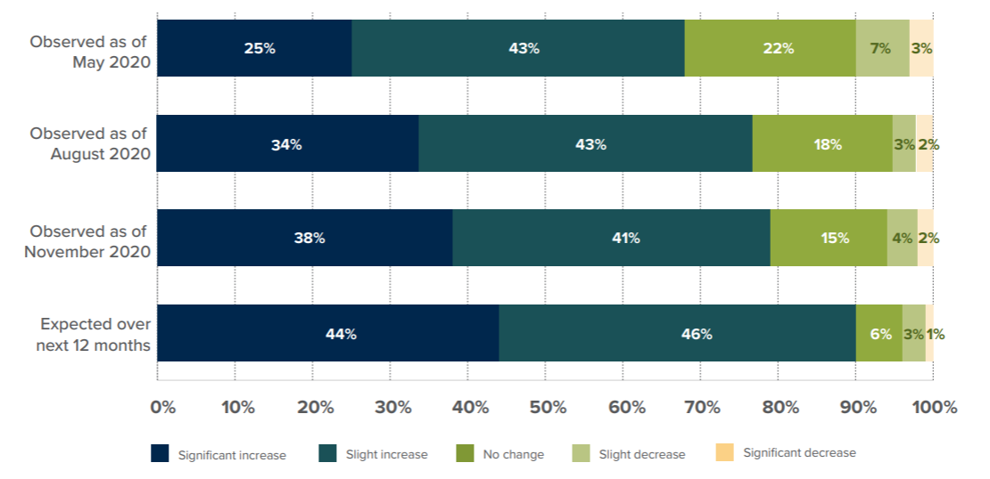
How Covid-19 is affecting the overall level of fraud?
As of Nov 2020, 79% of respondents said they have seen an increase in the overall level of fraud (compared to 77% in Aug 2020 and 68% in May 2020).
The trend is expected to persist: 90% of respondents expect an increase in the overall fraud level over the next 12 months.
Source: ACFE, Covid-19 Benchmarking Report December Edition

Slide 7
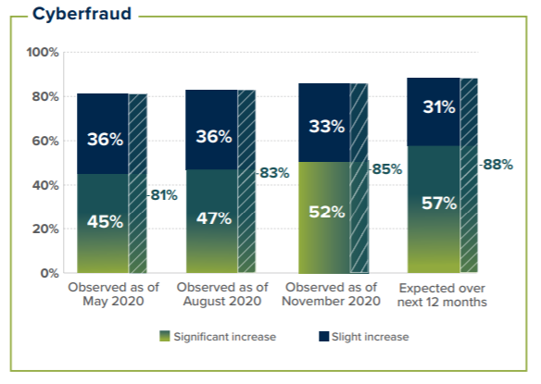
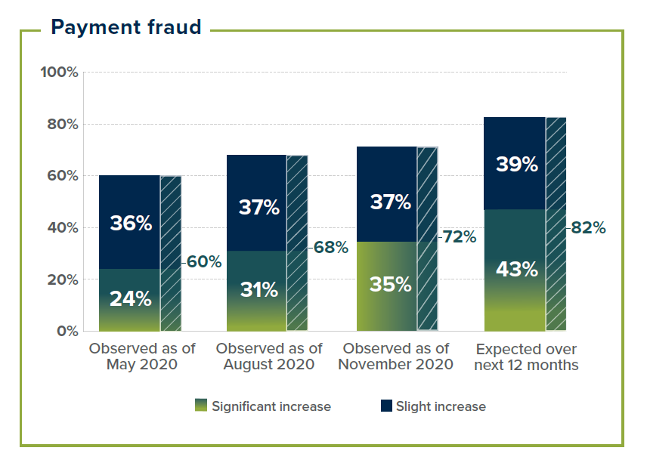
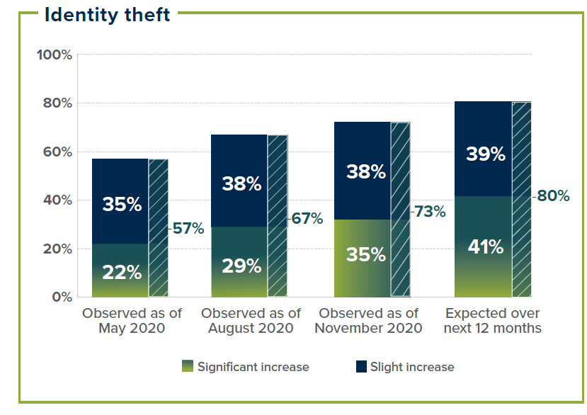
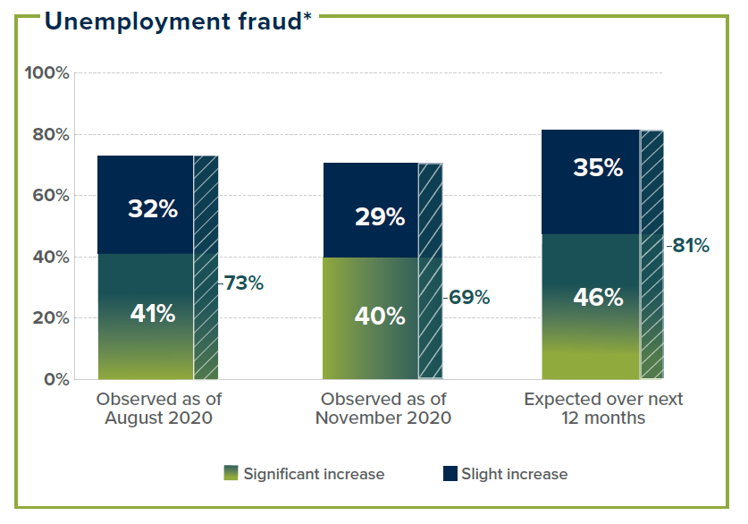
How Covid-19 is affecting specific fraud risks?
12 categories of risks studied
Some risks are affecting organizations more significantly than others.
Cybercrime (e.g., business email compromise, hacking, ransomware, and malware) - the most heightened area of risk, with 85% of respondents already seeing an increase in these schemes, and 88% expecting a further increase over the next year.
Other significant fraud risks in terms of both observed and expected increases: payment fraud (e.g., credit card fraud and fraudulent mobile payments), identity theft, and unemployment fraud.
Source: ACFE, Covid-19 Benchmarking Report December Edition

Slide 8
Key challenges during investigations and key lessons learned
2

Slide 9
Appropriate Fraud Response
Zero-Tolerance Culture
BoD / Audit Committee
Task Force
Investigators
Oversight of the Fraud Response Process
Lawyers
Start
Analysis of the circumstances
Appointment of an investigative team
Analysis of results and recommendations
Notification of stakeholders
Fact finding (preliminary investigation)
Presentation of results and recommendations
Detailed investigation (if needed)
Preparation of evidence
Establishment of the legal strategy
Taking legal action against perpetrators
Disciplinary actions
Criminal complaints
Litigation

Slide 10
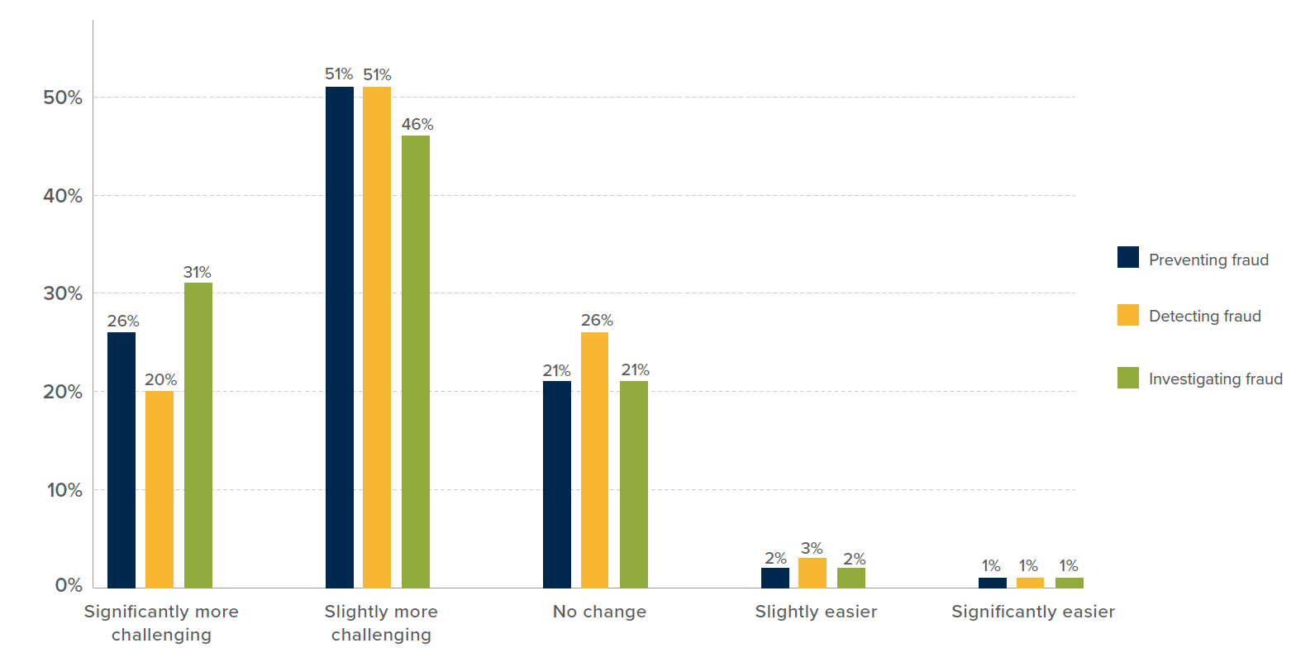
How Covid-19 is affecting the ability to fight fraud?
Change in difficulty level of anti-fraud activities
The majority of the survey respondents noted that preventing, detecting, and investigating fraud have become more difficult in
the wake of COVID-19.
77% of respondents indicated that fraud prevention and fraud investigation are more challenging now than they were previously—with 26% and 31%, respectively, saying that these activities are significantly more difficult.
71% of survey participants see fraud detection as more challenging (20% significantly so) than it was before the pandemic.
Source: ACFE, Covid-19 Benchmarking Report December Edition

Slide 11
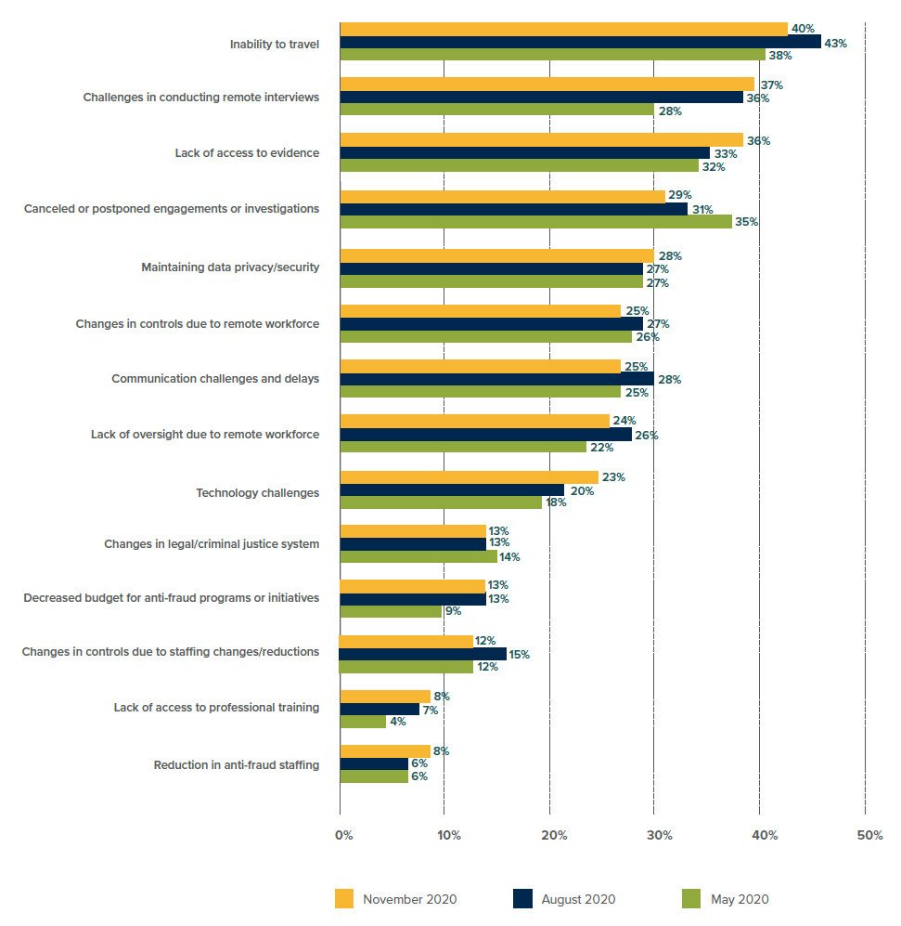
Common challenges in fighting fraud during Covid-19 times
Primary reasons fighting fraud has become more difficult in the wake of COVID-19:
The most common challenges are around physical restrictions placed on anti-fraud staff—including an inability to travel, difficulties in conducting remote interviews, and a lack of access to evidence.
While the general trends in these challenges have remained consistent, we have seen a slight decrease in respondents who are challenged by cancelled or postponed engagements (29% in Nov, down from 35% in May), as well as increases in those citing difficulties with remote interviews (37% in Nov, up from 28% in May) and technology challenges (23% in Nov, up from 18% in May).
Source: ACFE, Covid-19 Benchmarking Report December Edition

Slide 12
Challenges brought by COVID-19 in the investigation process
Interviews
Preferable face-to-face meetings - easier to establish rapport and assess credibility. By necessity, interviews are more frequently taking place virtually
Logistics aspects: ensure technology works, consider the best way to share documents, back-up plan if the remote platform runs into issues, secure storage and privacy of videoconferencing
Set ground rules for the interview: no recording, that the witness ensures they are alone unless accompanied by counsel, and that all documents and information be kept confidential and secured
Remote interviews may allow someone to record the interview. Employers should always assume that they are being recorded and what they say will be admissible in future proceedings. Measures to limit risk need to be considered (e.g. reminding an interviewee that they have no legal right to record the interview)
Data gathering
Hard copies of relevant documents may be harder to get if stored in closed locations
Need to arrange documents scanning and upload onto a document review platform as soon as it safe to do so.
Electronic data may also be difficult to source if kept locally on laptops or other devices held by employees. While remote access can solve these issues, companies need to update their data handling and security policies to account for increase remote working and maintain control over data

Slide 13
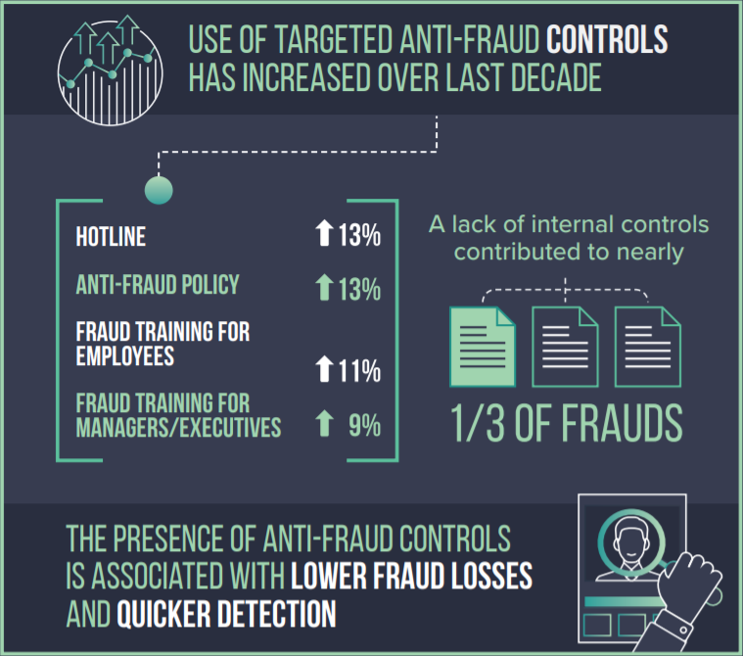
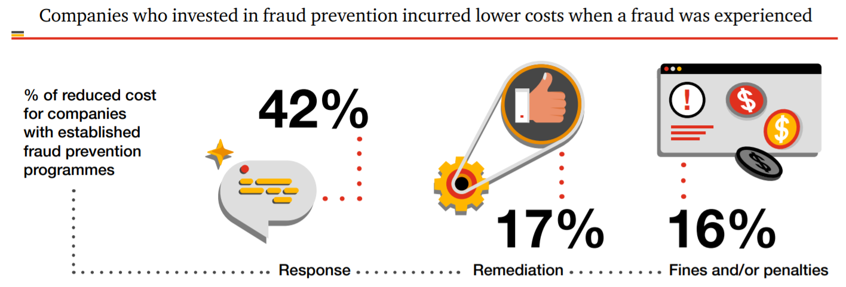
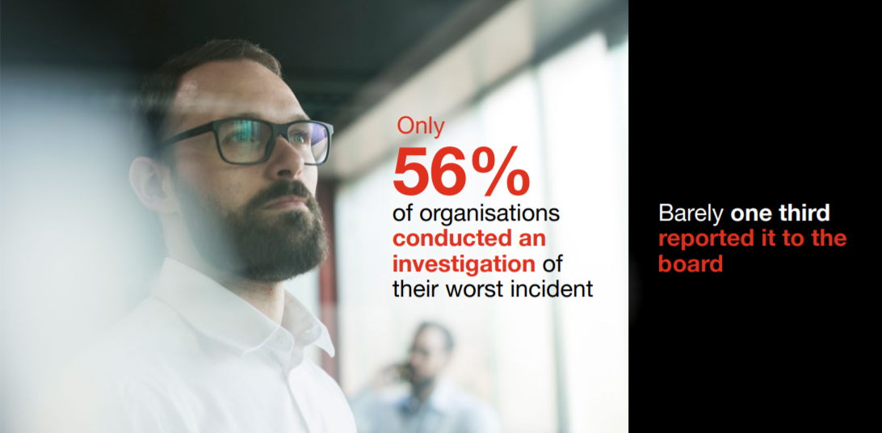
Proper anti-fraud controls are associated with lower fraud losses and quicker detection
Source: ACFE Report to the Nations 2020 / PwC GECS Report 2020

Slide 14
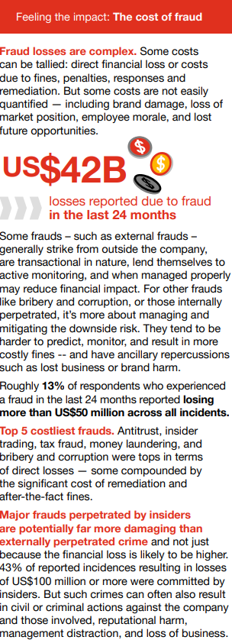
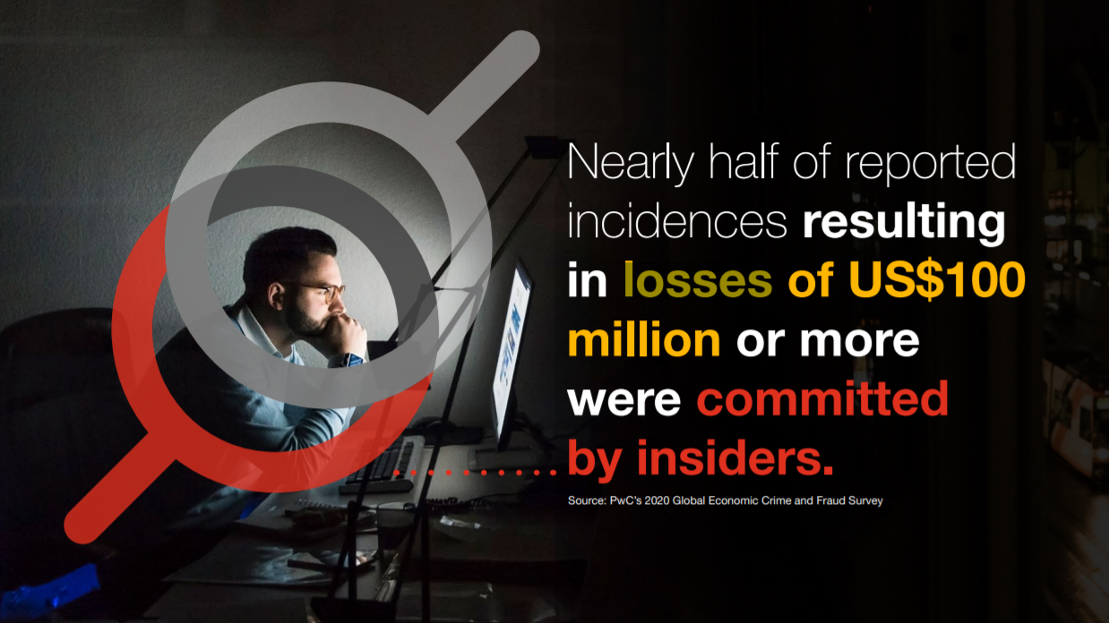
Feeling the impact – the cost of fraud
Source: PwC GECS Report 2020

Slide 15
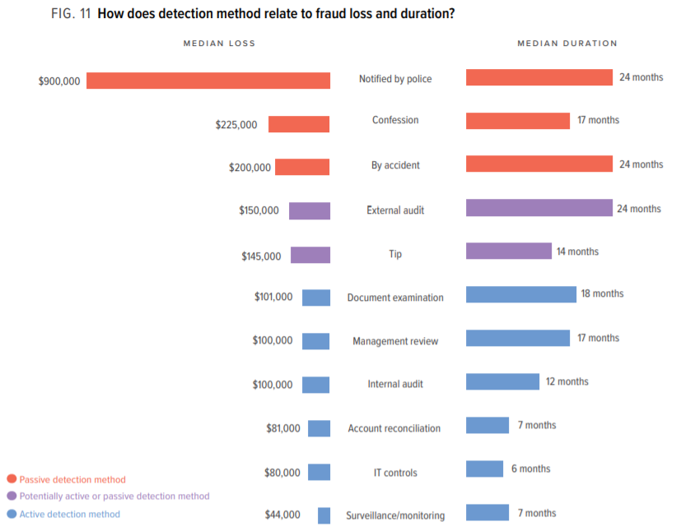
Median loss and duration by Detection method
Source: ACFE Report to the Nations 2020

Slide 16
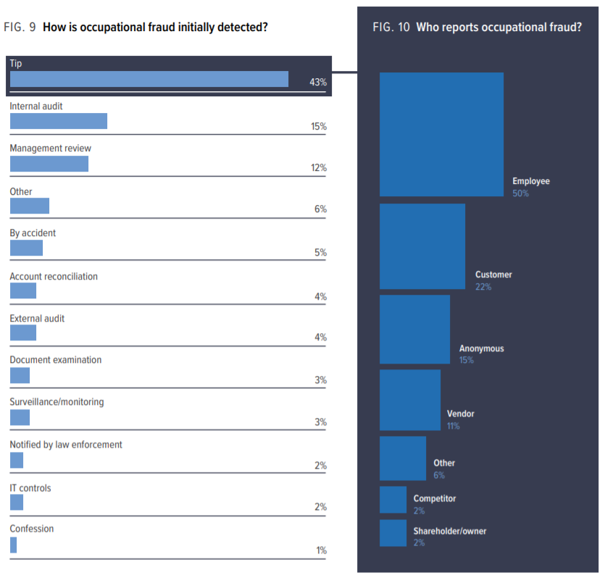

Who reported fraud incidents?
Source: ACFE Report to the Nations 2020

Slide 17
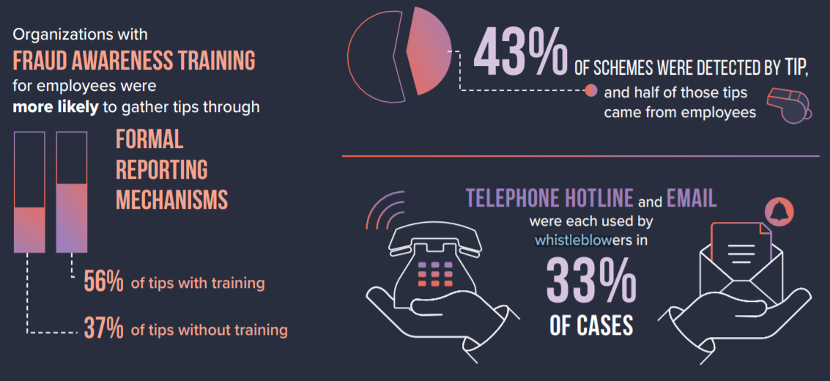
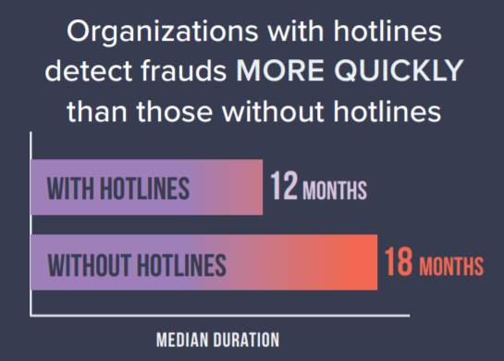
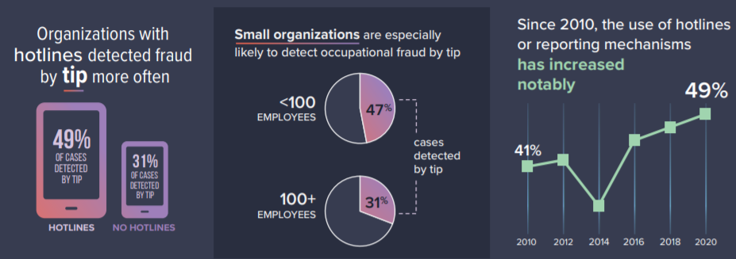
43% of frauds schemes detected by tips
Source: ACFE Report to the Nations 2020

Slide 18
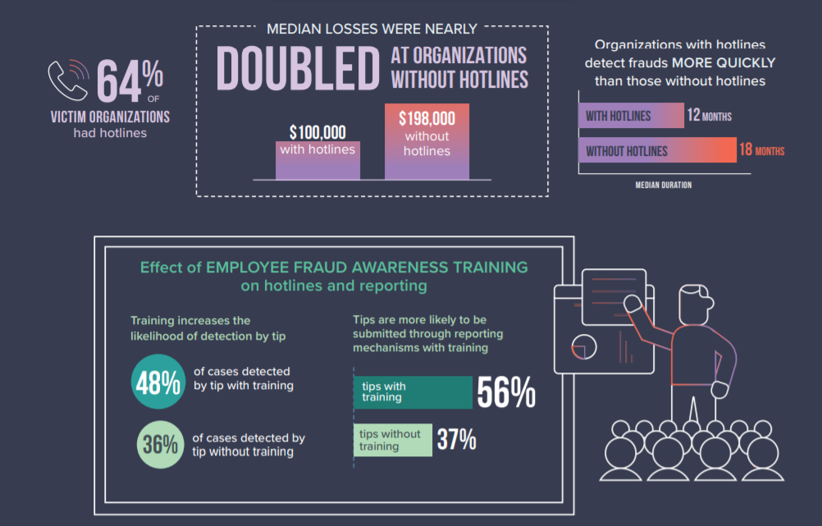
Reporting mechanisms effectiveness
“Protecting whistleblowers from unfair treatment, including retaliation, discrimination or disadvantage, can embolden people to report wrongdoing and increase the likelihood that wrongdoing is uncovered and penalised. Companies, public bodies and non-profit organisations should introduce mechanisms for internal reporting.”
- Transparency International
The three main reasons people do not report:
Fear of the consequences (legal, financial, reputational)
The belief that nothing will be done, that it will not make any difference
Uncertainty about how, where and to whom to report
Source: ACFE Report to the Nations 2020

Slide 19
Remediation actions – a must do once a fraud incident was discovered
How could companies better protect against fraud?
3

Slide 20
Key Components of an Anti-Fraud Program
Internal Environment and Objective Setting
Oversight by Audit Committee and Board
Code of Conduct/ Ethics
Whistleblower / hotline
Investigation / Remediation
Hiring and Promotion Procedures
Other Control Environment Considerations
Event Identification, Risk Assessment and Risk Response
Define Risk Spectrum
Identify Significant Areas of Risk within Each Fraud Category
Identify Fraud Schemes Related to each Fraud Category
Identify Business Units / Locations where Fraud Schemes are applicable
Monitoring
Control Activities
Consider Likelihood, Significance and Pervasiveness of the Risks identified
Reassess Fraud Risk
Change in circumstances
Acquisitions/ divestitures
Restructurings
Control issues
Monitor the Identified Controls
Evaluate Design and Effectiveness of Controls Identified
Link Control Activities to Fraud risks identified
Perform Fraud Auditing Procedures
Information and Communication
System Maintenance
Information Security
Change Management
Computer Operations
System Implementation

Slide 21
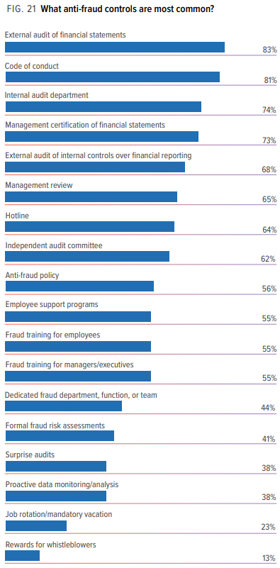
Source: ACFE Report to the Nations 2020

Slide 22
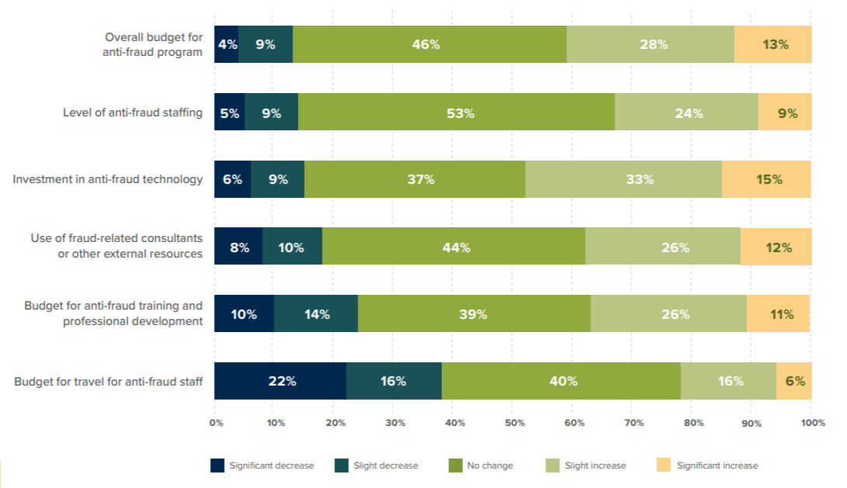
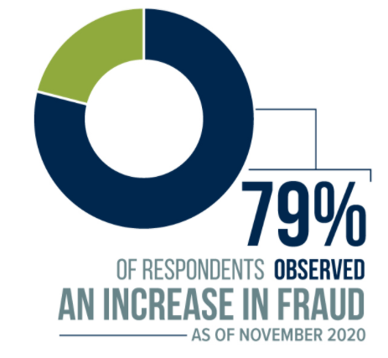
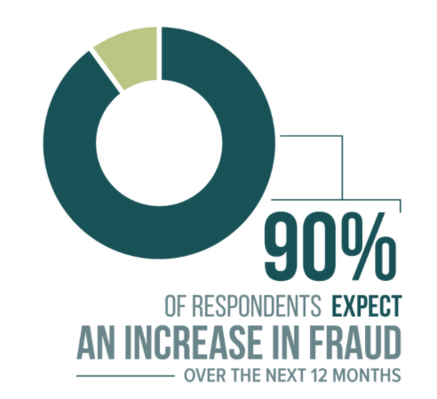
Expected anti-fraud program budgets and resources over the next 12 months due to Covid-19
Expected change in fraud trends for the next 12 months
November vs. December 2020
With the increase in overall fraud risk and the shifts in specific categories of fraud risk, organizations need to ensure that their anti-fraud programs remain effective over the coming year.
41% of organizations are planning to increase their overall anti-fraud budget, while only 13% anticipate a reduced budget for next year. Similarly, anti-fraud staffing is largely expected to either increase (one-third of organizations) or remain flat (53% of organizations), with just 14% expecting cutbacks or layoffs within their anti-fraud teams.
Nearly half (48%) of organizations anticipate increased investments in anti-fraud technology, and 38% plan to increase the use of fraud-related consultants or other external resources. Budgets for anti-fraud training and professional development are seeing a similar increase (37% of organizations), but almost one-quarter (24%) expect a decrease in this area.
The budget component most likely to see decreases is travel for anti-fraud staff; 38% of survey respondents anticipate a reduction in funds for travel.
Source: ACFE, Covid-19 Benchmarking Report December Edition

Slide 23

Thank you
Ana Sebov, ACCA, CAFR, CIA, CFE
Director
Forensic Services, PwC Romania
ana.sebov@pwc.com
+40 723 179 127
© 2021 PricewaterhouseCoopers Management Consultants S.R.L. All rights reserved. PwC and PricewaterhouseCoopers refer to the PwC network and/or one or more of its member firms, each of which is a separate legal entity. Please see www.pwc.com/structure for further details.
This publication has been prepared for general guidance on matters of interest only, and does not constitute professional advice. You should not act upon the information contained in this publication without obtaining specific professional advice. No representation or warranty (express or implied) is given as to the accuracy or completeness of the information contained in this publication, and, to the extent permitted by law, PwC does not accept or assume any liability, responsibility or duty of care for any consequences of you or anyone else acting, or refraining to act, in reliance on the information contained in this publication or for any decision based on it.
At PwC, our purpose is to build trust in society and solve important problems. PwC is a network of firms in 158 countries with more than 250,000 people who are committed to delivering quality in assurance, advisory and tax services. Find out more and tell us what matters to you by visiting us at www.pwc.ro.

