Slide 1

Cyprus Mergers & Acquisitions – What are your options?
Angeliki Epaminonda
Partner – Financial, Corporate, M&A
Cyprus M&A Insights: Creating Value for Clients in Difficult Times | 8 December 2020

Slide 2
M&A – Why Cyprus?
  Why Cyprus?
    Being both a member or the European Union and the Commonwealth, and being a former colony of the United Kingdom, Cyprus has inherited and developed modern comprehensive legal tools for merger and acquisitions transactions which can be used on a standalone basis or in combination in order to achieve the commercial objectives of the parties.
    Inexhaustive list of legislation typically applicable to an M&A deal:
    EU legislation and implementing national law
    The Companies Law Cap. 113
    The Cyprus Contract Law, Cap 149
    The Income Tax Law Ν. 118(I)/2002
PATRIKIOS PAVLOU & ASSOCIATES LLC

Slide 3
M&A – What are my options?
  Tools and options available under Cyprus law for M&A transactions:
    Classic share transfer and issuance and allotment of shares;
    Domestic reorganisations which include:
    merger,
    division,
    partial division,
    transfer of undertaking,
    share exchange,
    Cross-border merger within the European Union
CROSS-BORDER MERGER
REORGANISATION
SHARE SALE
PATRIKIOS PAVLOU & ASSOCIATES LLC

Slide 4
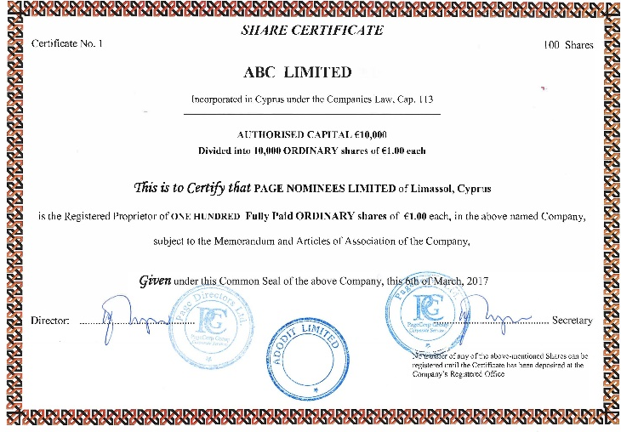

M&A – Share Acquisition
  Buyer acquires the shares in the company that owns and operates the business.
  The ownership of the business remains unchanged and continuity of trade is maintained.
  There is no need to transfer each underlying asset individually.
  Typically, a Letter of intent/Memorandum of Understanding is entered into setting out the commercial terms, followed by a confidentiality agreement and the initiation of a thorough corporate, financial and commercial due diligence of the Target.
  The share acquisition can take the form of:
  a purchase of shares from an existing shareholder of the Target; or
  the issuance and allotment of new shares by the Target.
  A share sale and purchase agreement or a subscription agreement is entered into setting out the terms and the completion mechanics.
  The actual transfer of shares or the issuance and allotment of shares in a Cypriot company is a fairly straight forward procedure and can be completed swiftly. If planned properly it offers minimal risks to both parties. Both procedures are internal procedures which do not require the processing by the regulating authority in order to take effect.
PATRIKIOS PAVLOU & ASSOCIATES LLC

Slide 5

M&A – Reorganizations
  The reorganisation procedure is applicable to domestic companies. When it comes to international acquisitions it’s usually used prior to or following an acquisition as a structure “tidy-up” tool.
  The most commonly used reorganisation is that of a merger, which can take the form of an upstream merger or a merger with another newly formed or pre-existing company. The effect is that one or more companies, on being dissolved without going into liquidation, transfer all their assets and liabilities to another existing or newly formed company or to the holding company.
  This procedure has been used as a less time-consuming alternative to a liquidation and avoids the stigma of liquidation since the dissolved company is deemed dissolved without undergoing liquidation.
  The procedural steps include:
    Preparation of up-to-date financial statements/management accounts;
    Obtaining the consent of the creditors;
    Entry into a scheme of arrangement;
    Obtaining a court order; and
    Filing the order with the Cyprus Registrar of Companies
    and Official Receiver.
  Reorganisations offer considerable tax benefits.
PATRIKIOS PAVLOU & ASSOCIATES LLC

Slide 6

M&A – Cross-border Merger
The EU Directives allowing the cross-border merger of a national limited liability company with a limited liability company from another Member State have been introduced in the Companies Law, Cap. 113.
The procedure entails the merger of at least two companies governed by the law of different Member States and can take the form of an inbound or outbound so that:
    one or more companies, on being dissolved without going into liquidation, transfer all their assets and liabilities to another existing company, in exchange for the issue to their members of securities or shares of the absorbing company, if applicable, a cash payment not exceeding 10 % of the nominal value, or, in the absence of a nominal value, of the accounting par value of those securities or shares; or
    two or more companies, on being dissolved without going into liquidation, transfer all their assets and liabilities to a company that they form, in exchange for the issue to their members of securities or shares of that new company and, if applicable, a cash payment not exceeding 10 % of the nominal value, or in the absence of a nominal value, of the accounting par value of those securities or shares; or
    a company, on being dissolved without going into liquidation, transfers all its assets and liabilities to the company holding all the securities or shares representing its capital.
PATRIKIOS PAVLOU & ASSOCIATES LLC

Slide 7
M&A – Recent M&A Deals
Mitsubishi UFJ Trust and Banking Corporation (The Trust Bank), a subsidiary of Mitsubishi UFJ Financial Group (MUFG), has entered into a share sale purchase agreement for the purchase of the shares of Point Nine Limited, a leading company that offers clients outsourced operations, processing and reporting for post-trade execution;
Iron Mountain Incorporated, the global leader in Enterprise Information Management Services acquired Fileminders Ltd a company offering record management, digital solutions and secure destruction;
Acquiring USB Bank by AstroBank. USB Bank’s personnel have been transferred to AstroBank;
MTN Cyprus, a Cyprus teleoom company was purchased by Monaco Telecom SA;
British Galileo Global Education purchased three Laureate Education Inc. owned schools, in a deal worth €225 million, including the European University of Cyprus;
Cablenet Communications Systems Limited, the only independent alternative telecommunications provider in Cyprus offering broadband, fixed telephony, television services through its wholly owned cable infrastructure and mobile telephony was purchased by GO PLC, a Maltese integrated telecommunications company.
PATRIKIOS PAVLOU & ASSOCIATES LLC

Slide 8







Contact me here:
PATRIKIOS PAVLOU & ASSOCIATES LLC

Slide 9

Thank you!
Patrician Chambers
332 Agiou Andreou str., 3035 Limassol, Cyprus
T. +357 25871599 | F. +357 25344548 | E. info@pavlaw.com
www.pavlaw.com

Slide 10
Takeover Law No. 41(I)/2007, as amended
  The law to make provision for public takeover bids for the acquisition of securities of companies and related matters, no. 41(I)/2007, as amended)
  Applicability
      Applies generally to every takeover bid for securities of a company registered in Cyprus and admitted to trading on a regulated market in Cyprus
      Also applies to every takeover bid for securities of a company not registered in Cyprus if certain requirements apply
  CySec jurisdiction
      Target registered office in Cyprus, all or some securities listed in Cyprus
      Target registered office in Cyprus, securities listed on another EEA regulated market
      Target registered outside Cyprus, securities listed only in Cyprus
      Target registered outside Cyprus, securities admitted to trading first in Cyprus and subsequently on another EEA regulated market
      Target securities simultaneously admitted to trading on regulated market in Cyprus and another EEA market and Target determined it will be under CySec supervision
      Other examples, more extreme, e.g. where Target registered office in Cyprus, GDRs securities listed on LSE – dual applicability of London takeover code and Cyprus takeover law
  Shared Jurisdictional table of CySec https://www.cysec.gov.cy/CMSPages/GetFile.aspx?guid=3f39f96c-6de7-4e7e-b1c0-cbf06c95189c
PATRIKIOS PAVLOU & ASSOCIATES LLC

