Slide 1

Cyprus Key Tax Features
George Yiallourides
Managing Director
Cyprus M&A Insights: Creating Value for Clients in Difficult Times | 8 December 2020

Slide 2


Group Financing Companies
DTT’s /EU status/ Low Corp. Tax / 0% Tax on dividends / 0% tax on capital gains
NID (Notional interest deduction): 10-year government bond yield + 5%
NID scheme has been approved by the EU Code of conduct Group and Ecofin as “not harmful”
Transfer pricing

Slide 3


IP Box Companies
Qualifying intangible asset (patents, computer software, other IP assets)
Qualifying profits is the fraction of the profits that will be taxed at 2.5%
QE + UE X OI
OE
Where:
OI is the “overall income derived from the QA”
QE is the “qualifying expenditure on the QA”
UE is the “uplift expenditure on the QA” and
OE is the “overall expenditure on the QA”
Overall income (OI) means the gross income accrued within the tax year, less the direct costs for generating such income
Qualifying expenditure (QE) is the sum of total research and development costs
Uplift expenditure (UE) lower of 30% of the QE or the total amount of the cost of acquisition and outsourcing to related parties for research and development in relation to the eligible intangible asset
Overall expenditure (OE) is the sum of QE, and the total acquisition cost of the qualifying asset and any R&D costs outsourced to related parties incurred in any tax year.

Slide 4

Non-Domicile Tax Residents
Non-domicile tax residents are those that are not considered as Cypriots and were not tax residents of Cyprus during the 17 out of the last 20 and our now tax residents either by the 183 days rules or the 60 days rules
Exempt from payment of taxes on worldwide income from:
  dividends
  interest
  rent
  sale of securities (shares in listed or non-listed Companies);
  no Inheritance Tax
  no Lifetime Gift Tax
Subject to tax and contributions on the following:
  50% of income taxes if Salary earned from employment in Cyprus exceeds 100k, 20% if less than 100k.
  National Health care contributions up to 180k income at 2.65%

Slide 5

Film Industry
Cyprus has an exceptional natural advantage. Being a small island with relevantly short distances, easily accessible, can enjoy a dramatic change of scenery.
Cash Rebate: A rebate of up to 25%-35% on eligible expenditures incurred in Cyprus.
Tax Credit up to 35% of the eligible expenditure made in the Republic of Cyprus. The sum of the tax credit against the taxable income shall not exceed 50% of the Applicants’ taxable income for the tax year within which the production is made.
Although the total aid cannot exceed 50% of the total production budget (or 60% in the case of a co-production), this limit can be lifted if the production can be deemed to be beneficial for the economy, culture, or the development of the Cypriot film industry.

Slide 6
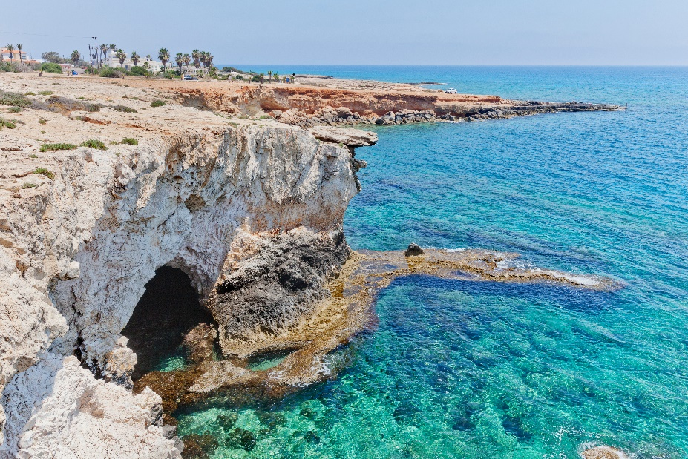
Film Industry
Other Incentives include
Tax Allowance for investment in infrastructure and equipment
Return of VAT on expenditure
Corporation Tax at 12.5% on net profits
0% tax on Dividends

Slide 7


Thank you!
Thank you!
4, Sotiri Tofini str.,
AUDEH QUARTERS, 1ST FLoor
Ayios Athanasios
4102 Limassol, Cyprus
T: +357 25 443131 F: +357 25 878948
www.ayca.com.cy

