Slide 1

CYPRUS – A Centre of Excellence
Lia Iordanou Theodoulou Partner – Head of Corporate Finance
Cyprus M&A Insights: Creating Value for Clients in Difficult Times | 8 December 2020

Slide 2
Cyprus “A Centre of Excellence” for international business activities
    VIDEO:
    https://www.youtube.com/watch?v=VcYEc7MakU0&feature=emb_logo
    Cyprus has established itself as a thriving business hub, with a vast array of investment opportunities in multiple growth sectors. The local economy has proved once again to be resilient in the current pandemic due to its small size, business friendly attitude and modern legislative framework. Determined to stay at the forefront of industry developments and continuously upgrading its legislative and regulatory regime, Cyprus aims to develop into a key regional financial hub for setting up investment funds and establishing asset management companies with a European and global reach.
PATRIKIOS PAVLOU & ASSOCIATES LLC

Slide 3
Headquartering, relocating to Cyprus
A myriad of reasons why
  Geographic strategic location
  EU Single Market
  High quality of life
    Mediterranean climate, clean air, crystal clear blue flag waters, warm people, hospitality, history, art and culture, low crime, high standard of housing, cuisine, exquisite hotels, marinas, outdoor activities, picturesque villages
  Advanced education system
  Reliable and familiar legislative framework
  Attractive and transparent tax regime
  Talented human resources, English speaking professional workforce
  Multinational companies have established regional headquarters
  Establishing a business is easy
  Effecting an acquisition or a merger is simple
PATRIKIOS PAVLOU & ASSOCIATES LLC

Slide 4
Examples of successful tech companies which
started, relocated or expanded in Cyprus
  See www.investcyprus.org.cy – “Grow your start-up in Cyprus” leaflet
    Wargaming Group
    Whipper
    Viber
    Proto.io
    NIPD Genetics
    MindGeek
    AVG
    Plath
    NCR
    2CX
    UTX Technologies Ltd
    Amdocs Ltd
    Openway
    Plus 500
    eToro
    TSYS
    Cardpay Ltd
    Playtech
    Learn2Play
    Asbis
PATRIKIOS PAVLOU & ASSOCIATES LLC

Slide 5
Economy Growth Sectors
  Traditional
    Tourism
    Shipping
    Financial services
    Real estate
    Agriculture
  Upcoming
    Natural gas
    Higher Education
    Fintech
    Research & Development (R&D)
    Renewable energy
    Intellectual Property (IP)
    Filming - Cyprus Film Industry scheme (aka OLIVEWOOD 😊)
    Innovative start-ups, high tech companies
PATRIKIOS PAVLOU & ASSOCIATES LLC

Slide 6
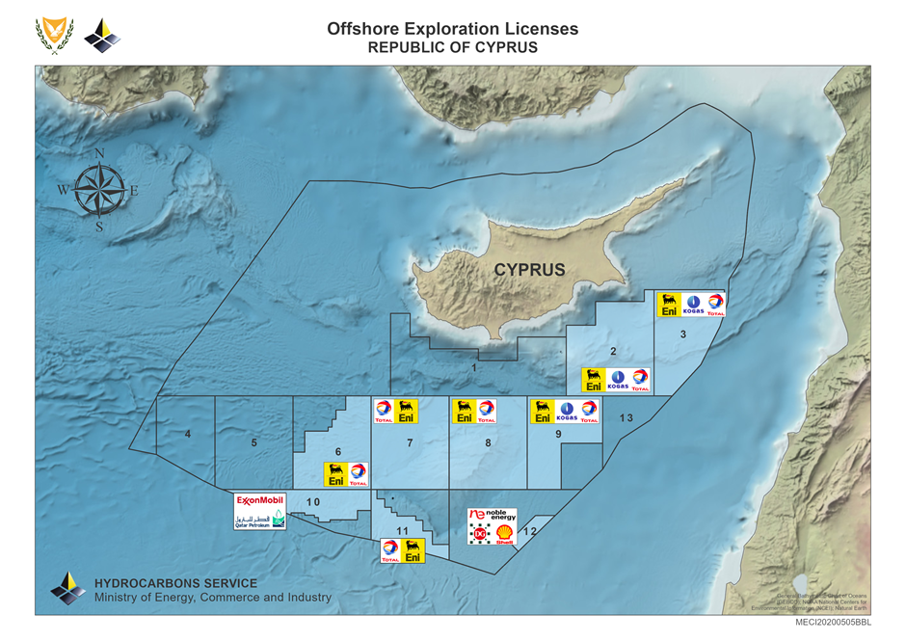
CYPRUS EEZ
PATRIKIOS PAVLOU & ASSOCIATES LLC

Slide 7

Exploitation Licence
  Block 12 – granted in November 2019
    NOBLE, DELEK, BG
PATRIKIOS PAVLOU & ASSOCIATES LLC

Slide 8
Start-up & Innovation Support
  Government supporting entrepreneurship and innovation in various manners
  Deputy Ministry for Research, Innovation and Digital Policy
  An ambitious transformation reform, leading Cyprus into the digital era
  A more dynamic, sustainable, knowledge based, competitive economy
  Cyprus Start-up Visa which allows entrepreneurs from countries outside the EU to establish a start-up in Cyprus.
    Work visas are available to enable companies to hire people from outside the EU whenever the required talent is not available locally
    Applications submitted via email, evaluated within 5 weeks
    After positive evaluation, visa initially granted for 2 years
    Prospective residence without time restriction if enterprise succeeds
    Criteria:
      Innovative
      Capital requirement EUR 20 000
      Undergraduate degree
  Tax benefits
PATRIKIOS PAVLOU & ASSOCIATES LLC

Slide 9

Cyprus – a leading maritime centre
    Shipping entrepreneurs since the 1960s
    Developed into an international shipping centre, combining both a sovereign flag and a resident shipping industry
    High quality services
    High safety standards
    Excellent shipping infrastructure
    Classified as the third largest fleet in the European Union
    Limassol considered to be the largest third party shipmanagement centre in the EU
    The only “EU approved Open Registry”
    Competitive ship registration costs
    Very competitive tax regime
      tonnage tax system, in full compliance with the EU shipping taxation framework
      favourable benefits applicable to:
        owners of Cyprus flag vessels
        Ship managers
        to owners of foreign flag vessels
        Charterers
      Tax benefits extended:
        profits from operation of vessels in shipping activities
        profits from the sale of vessels
        interest earned on funds used other than for investment purposes
        dividends paid directly or indirectly from shipping related profits
PATRIKIOS PAVLOU & ASSOCIATES LLC

Slide 10

Thank you!
Patrician Chambers
332 Agiou Andreou str., 3035 Limassol, Cyprus
T. +357 25871599 | F. +357 25344548 | E. info@pavlaw.com
www.pavlaw.com

